Slide 1
Statistical inference
Week 4, Computational Genomics
Notes:
We’ve all had various exposure to statistics. The perspective that I am trying to teach today is to understand a few key analysis that statistics is used in biomedical research and genomics: how to read statistics in biomedical literature, and when you do your own analysis, how to interpret the results.
We are trying to say something about the population, but in research we are usually given a sample, which is a random subset of the population.

Slide 2
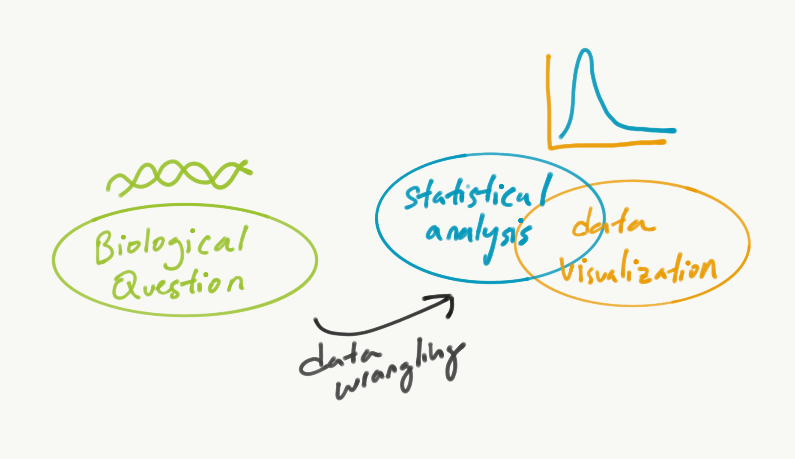
Notes:
Last week, we compared two distributions using difference in means, but also considered the sample size using a statistical test.
We assumed that the population distribution were identical, and examined how likely we were to see that in the data.
If not likely - there’s a difference
If likely - there’s no difference
Could we assume that the population distribution were different - that it it is particular difference and see how likely our data fit that hypothesis? Yes!
The point is: compared our data to a fixed value hypothesis.

Slide 3
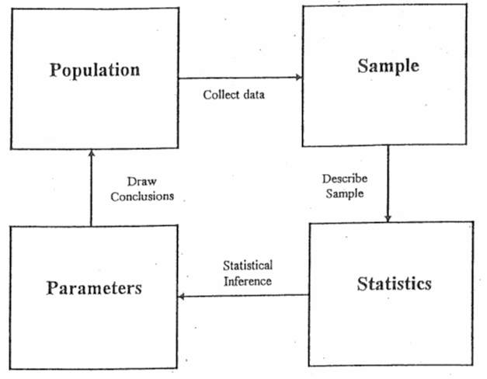
How certain are we about our conclusions?
Can we replicate this result again?

Slide 4
Population vs. Sample
Population: The entire collection of individual units that a researcher is interested to study.
Sample: A smaller collection of individual units that the researcher has selected to study.
Notes:
What are some examples of population vs. sample that you can think of?

Slide 5
Population vs. Sample
Population: The entire collection of individual units that a researcher is interested to study.
Sample: A smaller collection of individual units that the researcher has selected to study.
Population: Lung cancer cell lines
Sample: Cancer Cell Line Encyclopedia collection of lung cancer cell lines. The sample size is 273.

Slide 6
Population vs. Sample
Population | Sample
Lung cancer cell lines | CCLE’s collection of lung cancer cell lines
Iris plants (1920s?) | Iris dataset
Angiosarcoma Patients, n < 1,000 | Count Me In Enrollment of patient samples
Human genes, n ~ 20,000 | A collection of genes
Notes:
Population and sample size can vary greatly depending on the how abundant (prevalent?) it is, and the cost and accessible to get the sample
Angiosarcoma - small population, no sample at first. Now the sample size is relatively close the population size
Anything else you can think of? Cells in a biopsy for sequencing.

Slide 7
Samples taken are ideally random and independent
Population | Sampling Process | Sample | Measurement
Lung cancer cell lines |  | CCLE’s collection of lung cancer cell lines
Iris plants (1920s?) |  | Iris dataset
Angiosarcoma Patients, n < 1,000 |  | Count Me In Enrollment of patient samples
Human genes, n ~ 20,000 |  | Collection of human genes | Length of genes
Notes:
What kind of bias in sampling might be going on here?
Define independent - selection of elements from a population’s probability does not depend on previous sample. (ie. replacement vs. no replacement)
https://www.cancer.gov/pediatric-adult-rare-tumor/rare-tumors/rare-vascular-tumors/angiosarcoma
https://ascproject.org/
Sidenote to Count Me In, racial disparity in scientific research and advocacy:
https://www.youtube.com/watch?v=-L4BnpEJd30

Slide 8
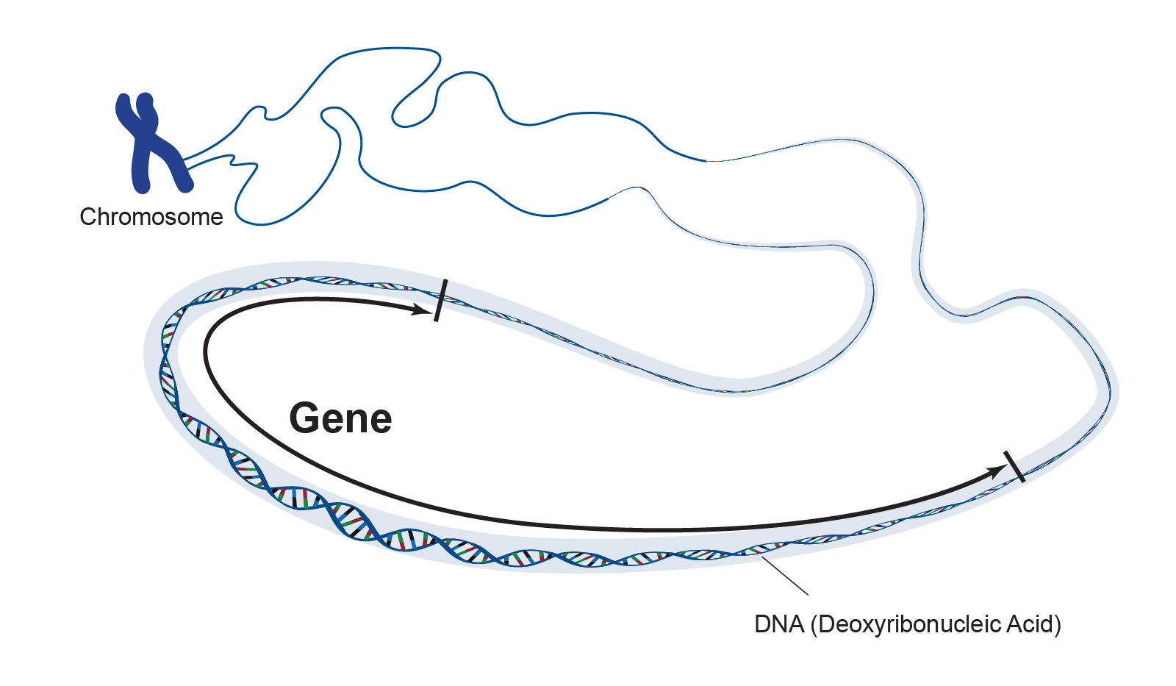
Notes:
Our choice of measurement is the length of a gene.
https://www.genome.gov/genetics-glossary/Gene

Slide 9
Notes:
How certain are we about our conclusions?
Can we replicate this result again?
The majority of biomedical research is not reproducible - why?

Slide 10
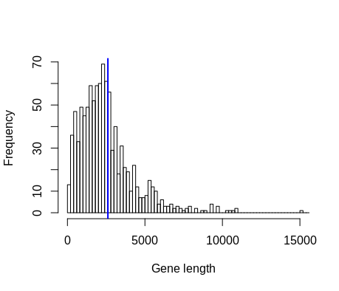
Describing a sample’s distribution
A distribution is the collection of observations for a specific measurement, often summarized visually in a histogram.
How can we summarize all of this information in a few quantities? A summarized measurement of the sample is called the sample statistic.
Notes:
Which one is the population distribution, sample distribution?
They look similar in shape!
How do we quantify some of the uncertainty in sampling? What is probability of sampling a range of values?

Slide 11
Describing a sample’s distribution
Population | Sample | Measurement | Sample Statistic
Lung cancer cell lines | CCLE’s collection of lung cancer cell lines |  | Mean difference between two groups
Iris plants (1920s?) | Iris dataset |  | Correlation between sepal.width, sepal.length
Angiosarcoma Patients, n < 1,000 | Count Me In Enrollment of patient samples
Human genes, n ~ 20,000 | Collection of human genes | Gene length | Mean gene length, median, mode, standard deviation, number of observations above/below a threshold
Notes:
Sidenote to Count Me In, racial disparity in scientific research and advocacy:
https://www.youtube.com/watch?v=-L4BnpEJd30

Slide 12
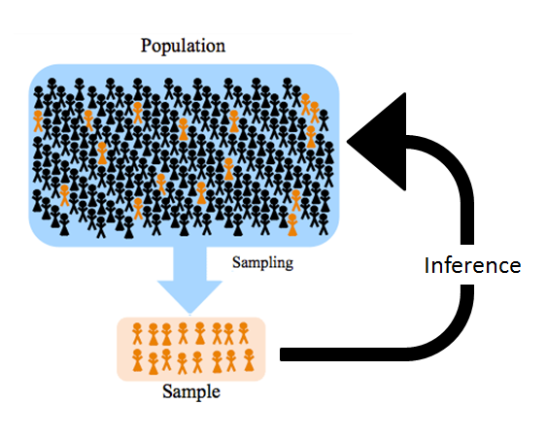
Ultimately, we are interested if the sample statistic accurately describes the population:
A summarized measurement of the population is called the population parameter.

Slide 13
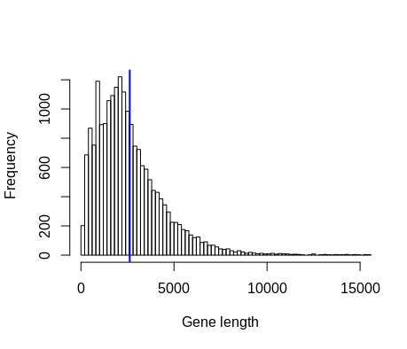
Population parameter vs. sample statistic
Notes:
Which blue line is the parameter, statistic?

Slide 15
A sample statistic is influenced by chance
genes = read.csv('~/Downloads/chap04e1HumanGeneLengths.csv')
population_param = mean(genes$geneLength)
genes_sample1 = sample_n(genes, 1000)
sample_statistic1 = mean(genes_sample1$geneLength)
genes_sample2 = sample_n(genes, 1000)
sample_statistic2 = mean(genes_sample2$geneLength)
…

Slide 16
What is the probability that our sample statistic is close to the population parameter?
In this perfect situation in which we know the population distribution, we can look at this sample statistic many times to see how close it is to the true population parameter.

Slide 17
Sample many times, see how likely the statistic is close to the population parameter
genes = read.csv('~/Downloads/chap04e1HumanGeneLengths.csv')
total_trials = 500
sample_size = 1000
all_statistics = c()
population_param = mean(genes$geneLength)
for(trial in 1:total_trials) {
genes_sample = sample_n(genes, sample_size)
statistic = mean(genes_sample$geneLength)
all_statistics = c(all_statistics, statistic)
}
all_statistics_df = data.frame(all_statistics)
ggplot(all_statistics_df) + geom_histogram(aes(x = all_statistics), bins = 100) + geom_vline(xintercept = population_param, col = "red") + labs(x = "Mean Gene Length")

Slide 18
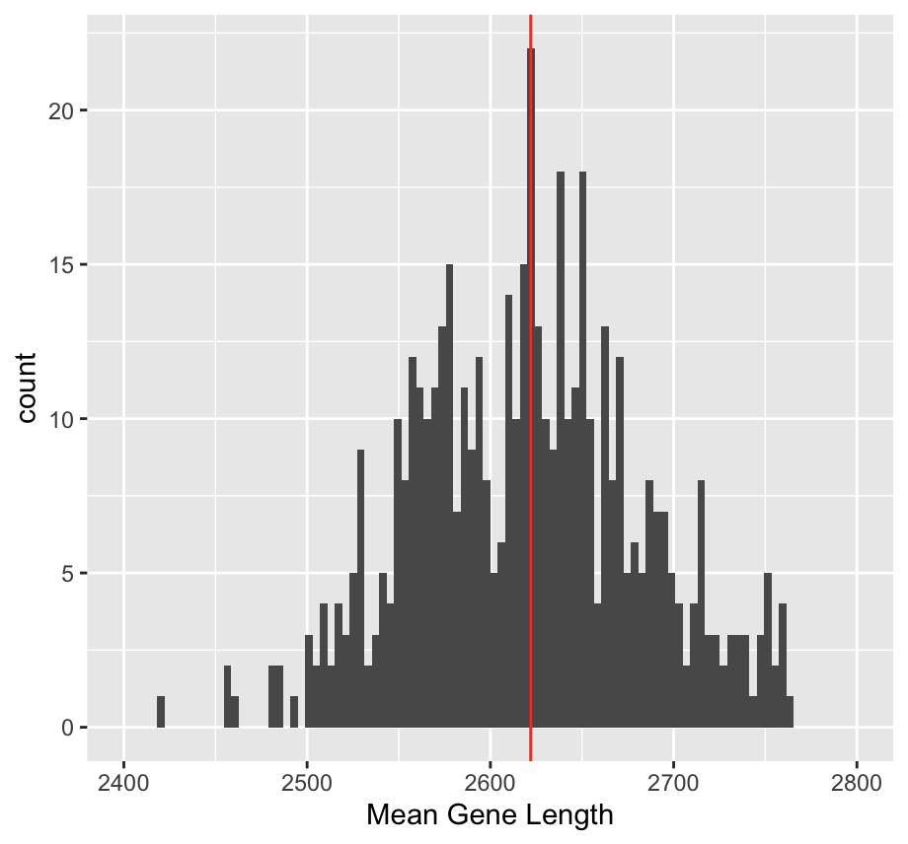
Sample many times, see how likely the statistic is close to the population parameter
The distribution of sample statistic is called the sampling distribution.
What is the probability that the sampling statistic is within 50bp of the population parameter?
Notes:
Red is the true population parameter.
What is the probability that the sampling distribution is within x basepairs of the true population parameter? What does it mean when the probability is high/low?

Slide 19
How does the sampling distribution change as you vary the sample size?
https://docs.google.com/document/d/1WCvYZljYMrtMhNGFlYfrPB8LpI_sTIc-GGLPwSKDcSY/edit?usp=sharing

Slide 20
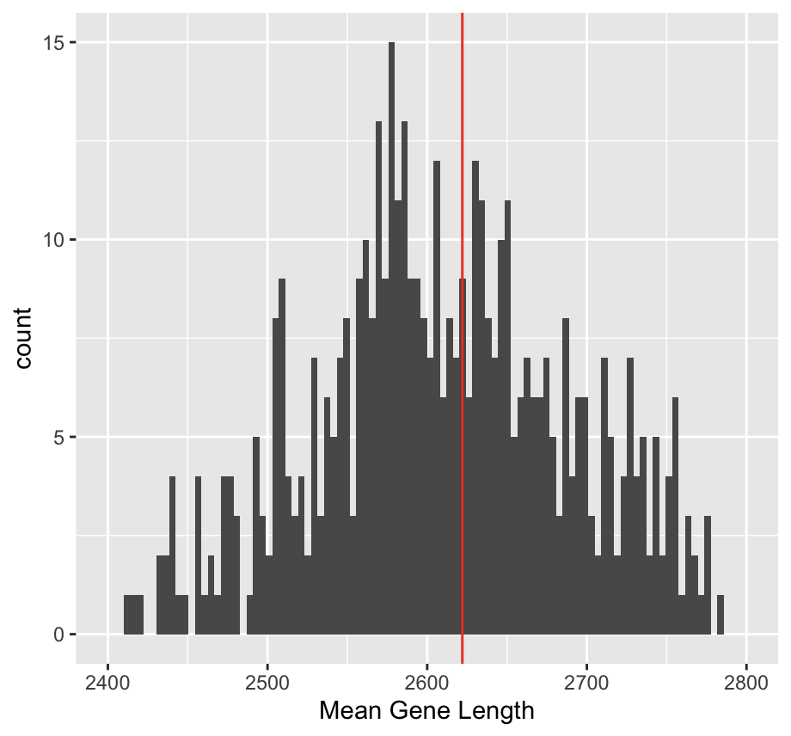
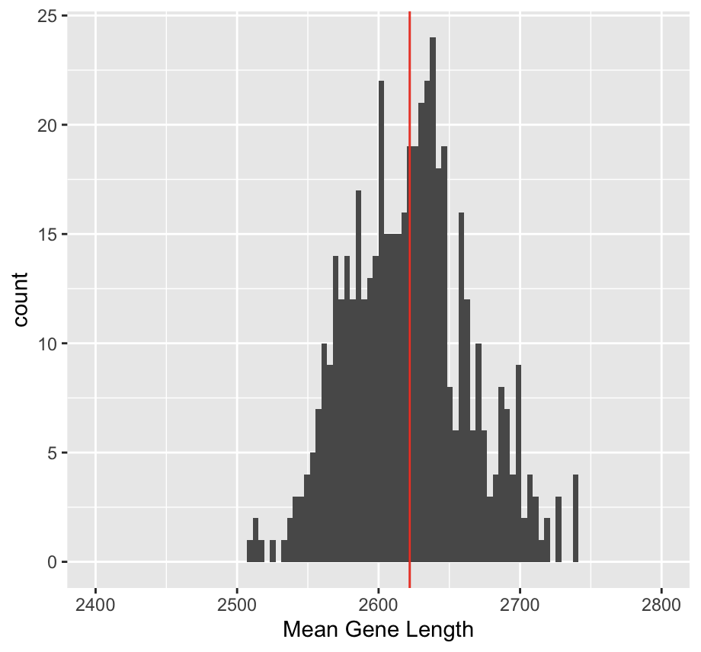
How does the sampling distribution change as you vary the sample size?
n = 500
n = 2000
What is the probability that the sampling statistic is within 50bp of the population parameter?
Notes:
What is the probability that the sampling distribution is within x basepairs of the true population parameter?

Slide 21
What have we learned about the relationship of parameter, statistic, and sample size so far?

Slide 22
What have we learned about the relationship of parameter, statistic, and sample size so far?
The probability of the sample mean (as a statistic) is close to the population mean (as a parameter) becomes higher when the sample size is larger.
The variability of the sampling distribution decreased as the sample size increased.
Notes:
What happens if the sample size approaches the population size?
The probability of the sample average being the population parameter approaches 1.
What happens to the variability of the sampling distribution as the sample size increased?
Decreased. This is directly related to the standard error.
How does this apply to other statistics?

Slide 23
The probability we computed answered: “what is the probability that the sample statistic is 100 bp from the population parameter?”
The confidence interval answers: “what is the range of values around the sample statistic that contains the population parameter with 95% confidence?”
“We are 95% confident that the population mean lies between 2121bp and 2702bp.”
Notes:
From Analysis of Biological Data book
Confidence interval gives a measurement of uncertainty where the population parameter lies. This is calculated through the variability of the sampling distribution and sample size
“
Imagine 20 researchers independently take unique samples of n=500 genes from the human genome. Each researcher calculates the sample statistic and the 95% confidence interval. Each research ends up with a different estimate and a different confidence interval. On overage, however, 19/20 of the researchers intervals will contain the the value of the population parameter. No individual researcher now for sure whether their CI contains the true population parameter, but each can be 95% confident.
“

Slide 24
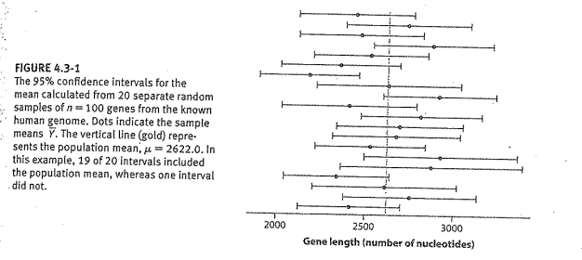
Notes:
From Analysis of Biological Data book
Confidence interval gives a measurement of uncertainty where the population parameter lies. This is calculated through the variability of the sampling distribution and sample size
“
Imagine 20 researchers independently take unique samples of n=1000 genes from the human genome. Each researcher calculates the mean and the 95% confidence interval. Each research ends up with a different estimate and a different confidence interval. On overage, however, 19/20 of the researchers intervals will contain the the value of the population parameter. No individual researcher now for sure whether their CI contains the true population parameter, but each can be 95% confident.
“

Slide 25
Notes:
Drawing conclusions
Sample statistic
Confidence interval
If making a test, hypothesis test and p-value
Qualitative descriptive is also okay! (“this skews in this direction…”) - Correlation!

Slide 26
Inference asks: what is the population parameter?
Hypothesis testing asks: is the population parameter a specific value?
What are some scientific situations that we care whether our answer is a specific value?
Notes:
Inference asks: what is the effect?
Hypothesis testing asks: is the effect a specific value? (is the effect we see purely based on chance, or is there actually an effect?)
What are some scientific scenarios do we want to use hypothesis testing compared to reporting a sample statistic + confidence interval?
examples:
whether there is a difference between two groups for vaccine efficacy. KRAS example.
whether the mean body temperature is 98.6F for patients in a drug trial.
---
Last week, we compared two distributions using difference in means, but also considered the sample size using a statistical test.
We assumed that the population distribution were identical, and examined how likely we were to see that in the data.
If not likely - there’s a difference
If likely - there’s no difference
Could we assume that the population distribution were different - that it it is particular difference and see how likely our data fit that hypothesis? Yes!
The point is: compared our data to a fixed value hypothesis.

Slide 27
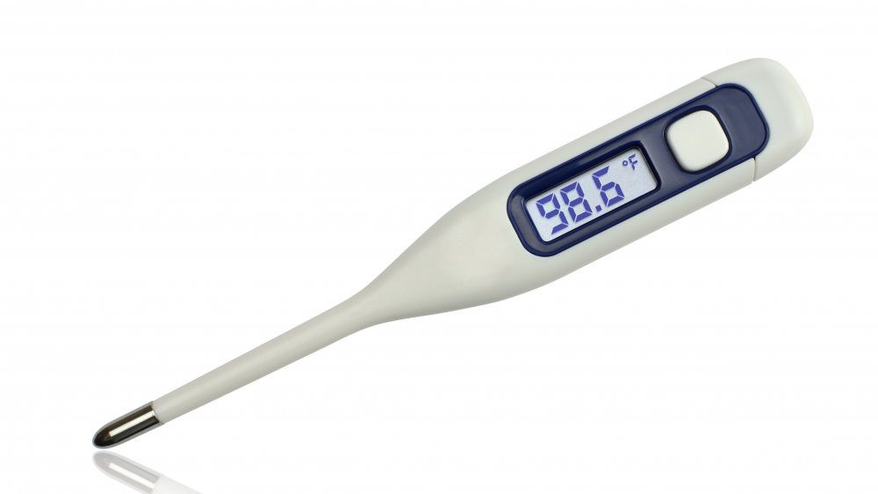
Notes:
Inference asks: what is the effect?
Hypothesis testing asks: is the effect a specific value? (is the effect we see purely based on chance, or is there actually an effect?)
examples:
whether there is a difference between two groups for vaccine efficacy. KRAS example.
whether the mean body temperature is 98.6F for patients in a drug trial.
Graphic: we want to see whether the true population parameter could be the null hypothesis.

Slide 28
Hypothesis testing framework
Come up with a null hypothesis of what population parameter is
What is the sampling distribution of the null hypothesis?
How well does the data fit the null hypothesis’ sampling distribution?
Compute P-value: measurement of how well the null hypothesis fits the data.
Do we believe the null hypothesis?
Notes:
The null hypothesis embodies the skeptical point of view - A good null hypothesis is something interesting to reject!
The null hypothesis is often the “normal value” - the normal body temp, - no effect/difference, no correlation - so that we can test whether the data deviates from the normal value.
Testing for 100f null hypothesis - rejecting it doesn’t mean much to us.
If the probability of obtaining the sample statistic or anything more different on the assumption that the null hypothesis were true is very small, do we believe the null hypothesis?
Another way of putting it - You come up with a model (a set of assumption of the data) that describes biological phenomena, and then you look at the data to see whether it fits the model.

Slide 29
Come up with a null hypothesis of what population parameter is:
Mean human temperature is 98.6F: T = 98.6

Slide 30
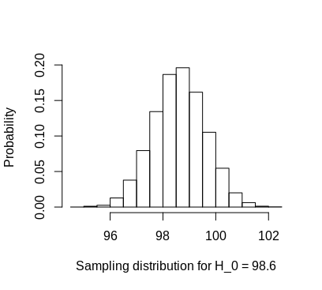
Come up with a null hypothesis of what population parameter is:
Mean human temperature is 98.6F: T = 98.6
2. What is the sampling distribution of the null hypothesis?

Slide 31
Come up with a null hypothesis of what population parameter is:
Mean human temperature is 98.6F: T = 98.6
2. What is the sampling distribution of the null hypothesis?
3. How well does the data fit the null hypothesis’ sampling distribution?
4. Compute P-value: measurement of how well the null hypothesis fits the data.
5. Do we believe the null hypothesis?

Slide 32
Hypothesis testing for mean of a population
> t.test(patient_samples$temperature, mu = 98.6)
One Sample t-test
data: patient_samples$temperature
t = -0.9456, df = 999, p-value = 0.0324
alternative hypothesis: true mean is not equal to 2622
95 percent confidence interval:
99.031 100.32
sample estimates:
mean of x
99.675
Notes:
A statistical test conducts a hypothesis test: a function that….
you give it your sample data and your null hypothesis.
It returns the population parameter estimates, confidence interval, and p-value.
Inference asks: what is the effect?
Hypothesis testing asks: is the effect a specific value?
Typically we need to answer both.

Slide 33
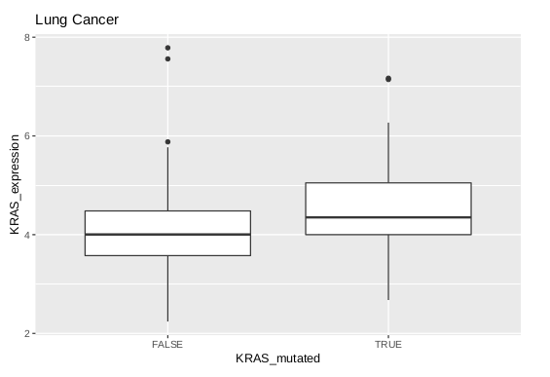
Hypothesis testing for difference of means of a population
Sample statistic: mean(KRAS MT expression) - mean(KRAS WT expression)
Null hypothesis: mean(KRAS MT expression) - mean(KRAS WT expression) = 0
Notes:
Here, we are using two variables at once: mutation status and gene expression. (What does the dataframe look like?)

Slide 34
Hypothesis testing for difference of means of a population
Sample statistic: mean(KRAS MT expression) - mean(KRAS WT expression)
Null hypothesis: mean(KRAS MT expression) - mean(KRAS WT expression) = 0
t.test(KRAS_expression ~ KRAS_mutated,
analysis)
t = -3.0646, df = 69.117,
p-value = 0.003107
95 percent confidence interval:
-0.7749738 -0.1638513
sample estimates:
mean in group FALSE mean in group TRUE
4.059474 4.528887
Notes:
T.test function by default tests for no difference in mean.

Slide 36
Is statistical significance biologically significant?
The difference between the null hypothesis and population parameter is the effect size.
Notes:
1. A difference of .1F in body temperature.
1. An association that makes no sense - chocolate consumption and nobel prizes, etc.
2. KRAS scenario in which there’s a big difference, but not statistically significant, because the sample sizes are too small.
3. The new variant of COVID shows no difference in vaccine response compared to current variant of COVID.

Slide 37
Is statistical significance biologically significant?
The difference between the null hypothesis and population parameter is the effect size.
Can you think of a situation in which statistical significance is reached but the result is not biologically significant?
Can you think of a situation in which biological significance is reached but the result is not statistically significant?
Can you think of a situation in which it is important to show no effect, biologically or statistically?
Notes:
1. A difference of .1F in body temperature.
1. An association that makes no sense - chocolate consumption and nobel prizes, etc.
2. KRAS scenario in which there’s a big difference, but not statistically significant, because the sample sizes are too small.
3. The new variant of COVID shows no difference in vaccine response compared to current variant of COVID.

Slide 38
Extra slides

Slide 39
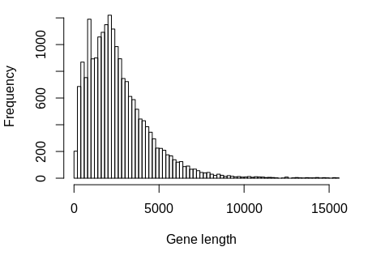
Using probability to understand uncertainty in sampling
What is the probability that a gene sampled from the population is less than 5000bp? P(g < 5000)
Probability of an event = # outcomes for event / # total possible outcomes
Notes:
If we know something about the population, how can we figure out something about P(sample)?
How would we do this in R?

Slide 40
Using probability to understand uncertainty in sampling
What is the probability that a gene sampled from the population is between 5000bp and 6000bp? P(5000 < g < 6000)
Probability of an event = # outcomes for event / # total possible outcomes
Notes:
Summary: We just quantified the probability of the sample based on the population. We will later use this tool to quantify the probability of how close the sample is to the population.

Slide 41
Using probability to understand uncertainty in sampling
What is the probability that 1000 genes sampled from the population is between 5000bp and 6000bp? P(5000 < g1 < 6000 & 5000 < g2 < 6000 & …)
Probability of an event = # outcomes for event / # total possible outcomes
Notes:
Do you think this probability is high or low?
Summary: We just quantified the probability of the sample based on the population. We will later use this tool to quantify the population based on the sample.

Slide 42
Interpreting the p-value
If the probability of observing the sample statistic and more extreme values is small under the null hypothesis, we reject the null hypothesis, favoring the alternative hypothesis.
If the probability of observing the sample statistic and more extreme is large under the null hypothesis, we don’t reject the null hypothesis.
“Small” often means < 5%.

